Slide 1
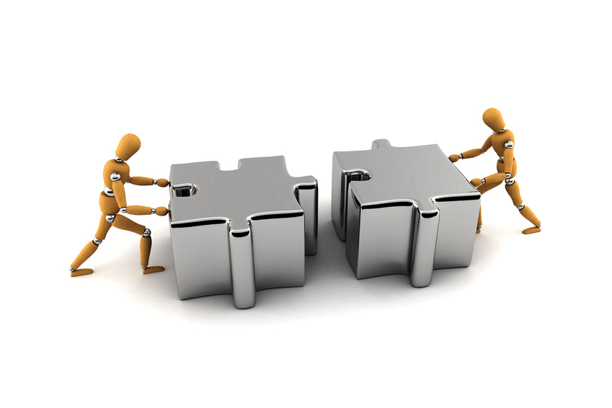
Problem Solving
= 64
A + B

Slide 2
What is the sum of the even numbers between 1 and 10?
Answer: 20

Slide 3
What is the sum of the odd numbers between 1 and 17?
Answer: 63

Slide 4
What is the sum of the odd numbers between 3 and 21?
Answer: 96

Slide 5
Trevor started lifting weights and he lifted 2 lbs. on the first night, and 7 lbs. on the second night. On the third night he lifted 12 lbs. Every night he lifted 5 more lbs. than he had the night before. If Trevor kept increasing his lifting weight, on what night would he lift more than 60 lbs.?
Answer: 13th

Slide 6
Amy started counting sheep to get to sleep and she counted 3 on the first night, and 7 on the second night. On the third night she counted 11. Every night she counted 4 more sheep than the night before. If Amy kept increasing her sheep, on what night would she count more than 40 sheep?
Answer: 11th

Slide 7
Mrs. Wolfe is making cookies for a class of 40 students. Her recipe only makes cookies for 5 large cookies, how much sugar will she need to use to make enough for all 40 students?
Recipe
1/2 cup flour
1/2 cup sugar
1/2 cup peanut butter
Answer: 4 cups

Slide 8
List the amount of water needed if the following recipe is tripled.
Mix together:
1 1/2 cups flour
1 1/3 cups water
1 1/4 tsp. cream of tartar
3/4 Tbsp. oil
Answer: 4 cups

Slide 9
If 2 cups of sugar are needed to make 4 quarts of lemonade, how many cups of sugar are needed to make 10 quarts of lemonade?
Answer: 5

Slide 10
Jesse wants to make a pot of broccoli soup that serves eight bowls. To make two bowls, she needs two cups of broccoli, 1 ½ cups of milk, and ½ teaspoon salt. How much milk will she need to make the eight bowls of soup in the pot?
Answer: 5 cups

Slide 11
How many right angles are in this diagram of a house?
Answer: 19

Slide 12
How many right angles are in this diagram of a house?
Answer: 25

Slide 13
There are 81 french fries in a large
order of fries. A small order of fries is one-third the size of a large order of fries. How many more fries are you getting in a large order compared to the small order?
Answer: 54

Slide 14
There are 64 ounces of shampoo in a large bottle. A small bottle is one-fourth the size of a large bottle. How many more ounces are you getting in a large bottle compared to the small bottle?
Answer: 48

Slide 15
How many 2-digit numbers can be made that meet all these requirements:
1. The digit in the ones place is less than 3.
2. The digit in the tens place is greater than 6.
Answer: 9

Slide 16
How many 3-digit numbers can be made that meet all these requirements:
1. The digit in the ones place is less than 3.
2. The digit in the tens place is greater than 7.
3. The digit in the hundreds place is odd.
Answer: 30

Slide 17
Harry Potter was 11 years old in 1997 when the first book came out. If Harry Potter were a real person, how old would he be in 2012?
Answer: 26 years old

Slide 18
My great-grandfather was born in 1899, how old would he be in 2012?
Answer: 113 years old

Slide 19
J.K. Rowling sold more than 450 million books in the Harry Potter Series. If the books first appeared in 1997, on the average, how many books were sold each year through 2011?
Answer: 30 million

Slide 20
The sum of any three numbers along the straight lines is 17. What number should N be?
1
8
2
N
Answer: 9

Slide 21
The sum of any three numbers along the straight lines is 15. What number should N be?
6
8
N
5
Answer: 3

Slide 22
The sum of any three numbers along the straight lines is 12. What number should N be?
7
9
N
4
Answer: 2

Slide 23
What two-digit number goes in the box to make this problem correct?
230 + 20 = 25 x
Answer: 10

Slide 24
What two-digit number goes in the box to make this problem correct?
150 + 30 = 3 x
Answer: 60

Slide 25
What two-digit number goes in the box to make this problem correct?
200 + 40 = 10 x
Answer: 24

Slide 26
How many of the numbers 0-9 are made using
only straight line segments?
Answer: 3 numbers (1, 4, 7)

Slide 27
How many letters of the alphabet j-z are made using
only straight line segments?
Answer: 9 (k,l,t,v,w,x,y,z)

Slide 28
It takes Doug 15 skips to go across the track. It takes Caroline 20 skips. If Doug has taken 9 skips, how many skips has Caroline taken?
Answer: 12

Slide 29
It takes Fred 10 minutes to swim the lake. It takes Cathy 15 minutes to swim the same lake. If Fred swam a race for 30 minutes. How long would it take Cathy to swim the same distance as Fred?
Answer: 45 minutes

Slide 30
Ian has 8 guitars that need 6 strings each. He has 6 guitars that need 12 strings each. Each string costs $1.25. How much will the strings cost him?
Answer: $150

Slide 31
Jordan has 5 necklaces that need 4 beads each. She has 7 necklaces that need 10 beads each. Each bead costs 20 cents. How much will the beads cost her?
Answer: $18

Slide 32
On July 2nd Cameron will begin playing soccer every fourth day. He is also scheduled to swim every fifth day, beginning on July 3rd. On what date in July will Cameron be doing both sports?
Answer: 18th

Slide 33
On March 4th Darius will begin playing baseball every third day. He is also scheduled to play tennis every fourth day, beginning on March 5th. On what dates in March will Darius be playing both baseball and tennis?
Answer: 13th, 25th

Slide 34
What is the perimeter of the shape?
10 cm
10 cm
Answer: 100 cm

Slide 35
What is the perimeter of the shape?
20 cm
20 cm
Answer: 320 cm

Slide 36
What is the perimeter of this shape?
16 ft.
3 ft.
10 ft.
12 ft.
Answer: 52 ft.

Slide 37
What is the perimeter of this shape?
16 ft.
4 ft.
14 ft.
5 ft.
5 ft.
5 ft.
Answer: 60 ft.

Slide 38
The fourth graders at Pinebluff School made an obstacle course. The course had five sides and started and ended at the same place. Two sides were 45 feet long and three sides were 20 feet long. What was the total distance in yards around the course?
Answer: 50 yards

Slide 39
The area of a square is 36 square
meters. What is the perimeter of the square?
Answer: 24 meters

Slide 40
Brandon is stacking bricks for his father. He pays him 50¢ for the first brick and increases his pay by 25¢ per brick. How many bricks will he have to stack to earn $11.00?
Answer: 8

Slide 41
Harvey collects worms for his grandfather's bait shop. His grandfather pays him two cents for each worm. How many worms must Harvey collect to have $4.70?
Answer: 235

Slide 42
Trevion's father promised to pay him to dig 10 boxes of worms. Trevion said he would do it if he would pay him 5 cents for the first box, 10 cents for the second, and so on, doubling the amount for each box. How much would his dad have to pay for the 10 boxes?
Answer: $51.20

Slide 43
Debbie and her friends made 63 brownies to sell at the bizarre this morning. They sold 1 brownie in the first hour, 2 brownies in the second hour; and 4 brownies in the third hour. If they keep doubling the amount of brownies they sell each hour, how many hours in all will it take them to sell all the brownies?
Answer: 6 hours

Slide 44
Jordan wants to order a present from a catalog for Ally's birthday on July 14. It takes four weeks for the delivery starting the day after the order is placed. What is the latest date he can order the present for it to arrive on the 14th?
Answer: June 16

Slide 45
For the third grade bake sale, Zanai
baked four dozen cookies. Only two and one-half dozen of her cookies sold. She gives each of her 16 classmates one of the left over cookies. How many cookies will she have for herself?
Answer: 2

Slide 46
For the carnival, Mrs. Black
baked six dozen cookies. Only 3 and one-half dozen of her cookies sold. She gave 22 cookies away. How many cookies will she have for herself?
Answer: 8

Slide 47
For the church bizarre, Mr. Tate made eight dozen Christmas tree ornaments. Only 5 and one-half dozen of the ornaments sold. He gave 7 ornaments away. How many ornaments will he have left to put on his own tree?
Answer: 21

Slide 48
Brittany has a small pack of M&Ms.
When she opens the bag she finds six red, two green, six brown, three yellow, three blue, and four orange M&Ms. What fraction of her candy is either red or brown?
Answer: 1/2

Slide 49
Marc has a small pack of gumdrops.
When he opens the pack he finds one blue, two yellow, five purple, three orange, three green, two white, and five red gumdrops. What fraction of his gumdrops is either yellow or purple?
Answer: 1/3

Slide 50
A and B represent two different numbers. What numbers are A and B if:
A + B = 13, and
A x B = 36
A > B
Answer: A=9 and B =4

Slide 51
C and D represent two different numbers. What numbers are C and D if:
C + D = 16, and
C ÷ D = 3
D < C
Answer: C=12and D =4

Slide 52
X and Y represent two different numbers. What numbers are X and Y if:
X - Y = 20, and
X ÷ Y = 5
X > Y
Answer: X=25 and Y =5

Slide 53
Fill in the blanks to make a the
Subtraction problem correct.
5 1 3 6
3 6 9
2 8 1 4 1
Answer: 8, 2, 6

Slide 54
If all the symbols represent different digits, what does represent?
+
+
+
+
7 2
1 3
1 2
9
Answer: 1

Slide 55
If all the symbols represent different digits, what does represent?
+
+
+
+
8 3
7
1 5
10
Answer: 4

Slide 56
If all the symbols represent different digits, what does represent?
+
+
+
+
8 3
7
1 5
10
Answer: 4

Slide 57
Brad is taking a survey at Howie’s Hamburgers drive thru. He observes 16 cars in line and every person in each car orders a soft drink. No car contains more than four people. What is the difference between the most number of soft drinks and least number of soft drinks that could be purchased?
Answer: 48
64 (most) – 16 (least)

Slide 58
Mrs. Bevel's third grade class conducted a survey to determine the class’s favorite soda. They found that ½ of the class liked Cola best, 1/4 of the class liked lemon-lime best, and 1/4 of the class liked grape best. How many of the 24 students did not like cola?
Answer: 12

Slide 59
How many people like Chocolate?
Vanilla
Strawberry
7
2
4
8
3
1
6
Chocolate
Answer: 18

Slide 60
How many people like Soccer?
Soccer
Football
5
3
8
10
6
7
4
Baseball
Answer: 24

Slide 61
How many people like Dogs?
Cats
Dogs
12
8
11
15
9
9
2
Fish
Answer: 43

Slide 62
Farmer Brown had 4 ducks, 12 chickens, 6 mice, 21 cows, 7 horses, and 4 dogs. How many more heads than wings were on his 54 animals?
Answer: 54 – 32 = 22

Slide 63
Farmer Brown had 4 ducks, 12 chickens, 6 mice, 21 cows, 7 horses, and 4 dogs. How many more legs than wings were on his 54 animals?
Animals | Legs | Wings
4 Ducks | 8 | 8
12 Chickens | 24 | 24
6 Mice | 24
21 Cows | 84
7 Horses | 28
4 Dogs | 16
Total | 184 | 32
Answer: 184 – 32 = 152

Slide 64
The school secretary ordered folders for the supply store by rounding the number of students in each grade to the nearest 10 and doubling that number. How many folders did she order?
Grade | K | 1 | 2 | 3 | 4 | 5
# students | 77 | 82 | 86 | 84 | 91 | 95
Answer: 1040

Slide 65
The school secretary ordered pencils for the supply store by rounding the number of students in each grade to the nearest 10 and doubling that number. How many pencils did she order?
Grade | K | 1 | 2 | 3 | 4 | 5
# students | 56 | 52 | 48 | 54 | 51 | 55
Answer: 640

Slide 66
Using the digits 1, 5, 3, 4 once and only once,
what is the largest odd number you can write?
Answer: 5431

Slide 67
Using the digits 2, 6, 7, 9 once and only once,
what is the largest even number you can write?
Answer: 9762

Slide 68
Using the digits 3, 4, 5, 8 once and only once,
what is the largest even number you can write?
Answer: 8534

Slide 69
A digital clock shows either three or
four digits. What is the greatest sum that can be created from the digits?
Answer: 23 , 9:59

Slide 70
Demetri drops a ball from the top of a building that is 48 meters tall. It bounces half the height it is dropped on each bounce. How high will the ball bounce after its fourth bounce?
Answer: 3 meters

Slide 71
A virus is spreading throughout the school. Each day twice as many students are absent. On the first day 10 students were absent, how many were absent on the fifth day?
Answer: 160

Slide 72
One chapter of a book contains five pages. The sum of all the page numbers in the section is 50. What is the first page number of this chapter?
Answer: 8

Slide 73
One chapter of a book contains seven pages. The sum of all the page numbers in the section is 126. What is the first page number of this chapter?
Answer: 15

Slide 74
A customer gets a free lunch after paying for six at the Blue Plate Cafe. Caroline ate lunch there 60 times last year. How many free lunches did she get?
Answer: 8

Slide 75
A customer gets a free pizza after paying for five at Papa Aldo’s Pizza. Tom paid for 37 pizzas last year How pizzas did his family eat last year?
Answer: 44

Slide 76
Hans told Dee Dee to pick a number, add 12 to it, double that sum, and then subtract 4. Dee Dee's said her answer was 40. What number did she start with?
Answer: 10

Slide 77
George told Mark to pick a number, add 8 to it, double that sum, and then divide by 4. Mark said his answer was 10. What number did he start with?
Answer: 12

Slide 78
Chris told Brett to pick a number, double it, add 12 to it, and then subtract 3. Brett's answer was 41. What number did Brett pick?
Answer: 16

Slide 79
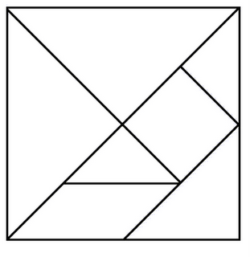
How much is this shape worth?
25
Answer: 2 dollars

Slide 80
How much is this shape worth?
25
Answer: 1 dollar

Slide 81
How much is this shape worth?
25
Answer: 4 dollars

Slide 82
It takes about three hours and 45
minutes to drive from Rachel's house to the beach. If her family wants to arrive at the beach by 4:30 p.m., when should they leave their house?
Answer: 12:45 pm

Slide 83
It takes Clyde one and one half hours to get to his job. If he has to begin work by 8:00 a.m. and he want to arrive 20 minutes early, what time will he need to leave his house?
Answer: 6:10 a.m.

Slide 84
It takes about 2 hours and 25
minutes to drive from Tom’s house to the city. If Tom wants to arrive at the city by 1:30 p.m., when should he leave their house?
Answer: 11:05 a.m.

Slide 85
Josie is very busy during the summer. She spends two weeks on a mission trip, one week at summer camp, one week at photography class, and three weeks at the beach. How many days does she spends at home on her ten week summer vacation?
Answer: 21

Slide 86
Asafa and Usain were running laps for the school track club. Asafa ran 9 more laps than Usain. By the end of practice, they had run 37 laps altogether. How many laps had Usain run?
Answer: 14

Slide 87
What 2-digit numbers are ten times the sum of their digits?
Answer: 10, 20, 30, 40,50,60,70,80,90

Slide 88
What 2-digit numbers are four times the sum of their digits?
Answer: 12, 24, 36, 48

Slide 89
What 2-digit number is two times the sum of its digits?
Answer: 18

